Slide 1
Principal Components Analysis

Slide 2
Today . . .
  Basic goals of principal components analysis
  Similarity to other procedures
  Simple example

Slide 3
Principal components analysis is a method for re-expressing a set of variables. It is used for:
  converting a large set of variables to a smaller number of linear combinations that contain most of the original information
  exploring the dimensionality in a set of variables
  eliminating multicollinearity in a set of predictors
  identification of outliers

Slide 4
Principal components analysis creates linear combinations of the original variables. Each successive linear combination:
  (a) Accounts for as much of the variance in the original variables as possible
  (b) Is independent of the previously created linear combinations

Slide 5
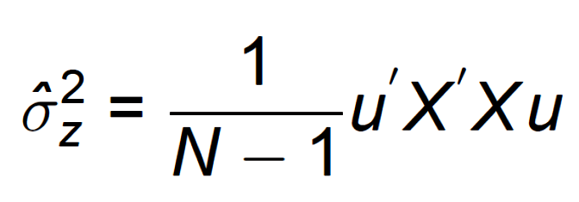
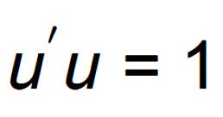
Principal components proceeds by seeking a linear combination (z) that is a weighted combination of the original variables (in standard score form), Xu, such that the variance of z has the largest value possible:
The weight vector, u, must be constrained in order to have a unique solution:
Notes:
X is in standard score form. The vector, u, is constrained to unit length (u`u = 1). The constraint that u have unit length is necessary for finding a solution.
Vector length is based on the Pythagorean rule. No need for the square root because the sum of squared values being 1 will produce a square root of 1 as well.

Slide 6
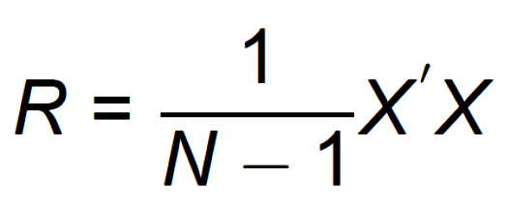
The problem can be recast as maximizing u`Ru.
This is sensible because the application of a vector of weights to a variance-covariance matrix will produce the variance of the linear combination that those weights would create if applied to the original data.

Slide 7
The weights that satisfy the variance-maximizing goal are called an eigenvector (u). The variance of the resulting linear combination is called an eigenvalue (λ).
If the original correlation matrix is of full rank (no perfect dependencies), then there will be as many eigenvectors and eigenvalues as there are original variables.
The collection of eigenvectors is contained in the matrix, U.
Notes:
The k variables can be transformed to k new and independent variables that completely account for the original variability.

Slide 8

The variance-covariance matrix of the principal components is a diagonal matrix, D, with the eigenvalues on the main diagonal:
The diagonal elements are the variances of the linear combinations. The off-diagonals are zero because the procedure creates linear combinations that are independent.
Notes:
U contains the multiple vectors, u, that create each linear combination.

Slide 9
Principal components analysis re-expresses the original variables. It simply rearranges the variance, shifting it so that most is contained in the first principal component, the next most in the second principal component, and so on.
This means that trace(D) = trace(R). The matrices D and R contain the same information, but in different arrangements.
Notes:
R is a variance-covariance matrix with variances of standardized variables on the main diagonal.

Slide 10
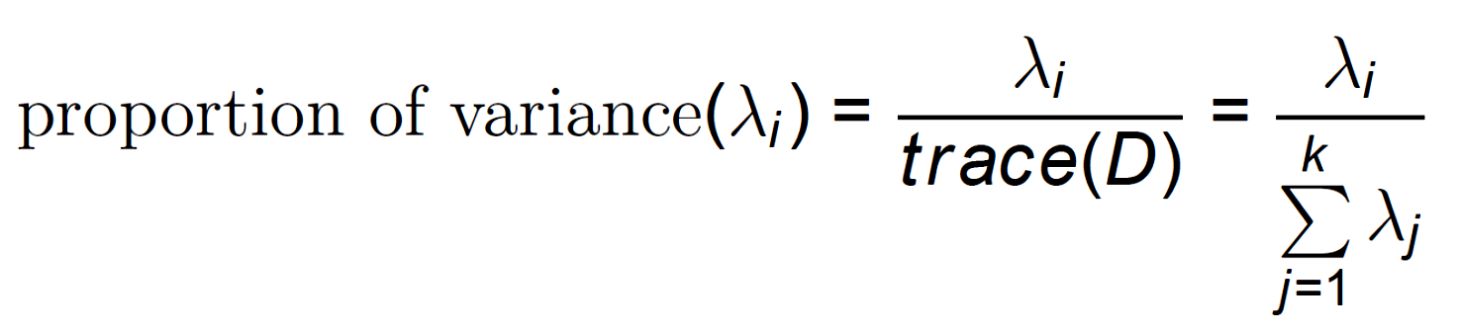
The proportion of variance that each principal component accounts for in the original data can be expressed as:

Slide 11
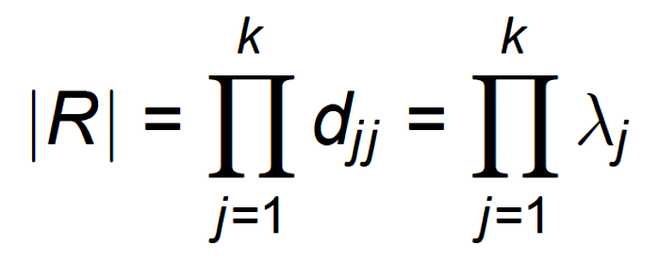
The determinant of R is usually complex to find. It can be found easily with D:
That the determinant of R is also the determinant of D is a reminder that principal components analysis simply rearranges the variance.
Notes:
Reminder that this can range from 0 to 1.

Slide 12
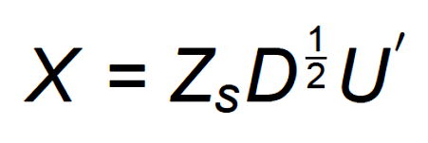
If Z_{s} is a matrix of standardized principal components scores, D is the diagonal matrix that contains variances for the principal components (the eigenvalues) and U is a matrix that contains the weights for creating the linear combinations (the eigenvectors), then:
Notes:
Z has unit length for each principal component, which is then re-scaled by D, and weighted by U. The transpose of U is needed because this calls for a combination of principal components to reproduce the variable X, not a combination of variables to create the principal components. (n pc) (pc pc) (pc v)

Slide 13
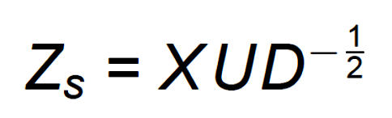
The formula can be rearranged to provide the principal components scores:
These might be used in other statistical analyses because of their desirable properties.
The meaning of the new linear combinations is sometimes easier to grasp by examining the correlations of the original variables with the new linear combinations—the principal component scores.
Notes:
(n pc) = (n v) (v pc) (pc pc)

Slide 14
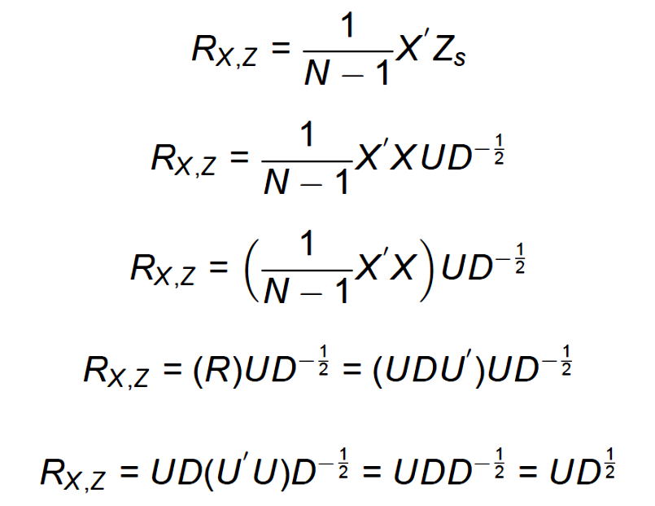
Notes:
UU’ is an identity matrix because each vector is of unit length and all vectors are independent.

Slide 15
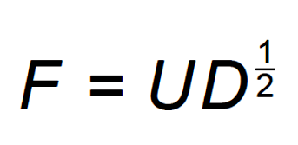
These correlations are called principal component loadings and are found by:
The principal component loadings are just a rescaling of the eigenvectors. The matrix, F, is called the structure matrix.

Slide 16
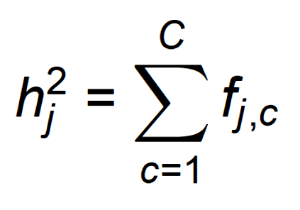
The proportion of variance for a variable in X that is accounted for by C principal components is called the communality:
Each element, f_{jc}, is a principal component loading.
The communality provides an index of how well the principal components can reproduce each of the original variables.
Notes:
The principal components are independent. The matrix of loadings is called the structure matrix.

Slide 17
Why does it make sense to simply sum the squares of these correlations to get the proportion of variance accounted for in X_{j} by the C components?
Notes:
The principal components are independent. The matrix of loadings is called the structure matrix.

Slide 18

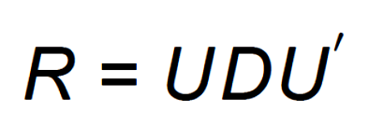
The variances of linear combinations can be obtained by applying the weights for the linear combinations to the covariance matrix of the original variables. In standard score form:
This also means that the correlations among the original variables can be recovered from the covariance matrix of linear combinations:
Notes:
The U matrix is orthonormal so U’U = UU’ = I.

Slide 19
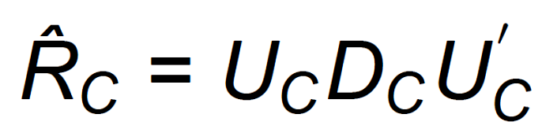
If all of the principal components are derived, the reconstructed correlation matrix will be exactly the original correlation matrix.
But, if only c components are derived, the reconstructed matrix will be an estimate of the original matrix, R, that is implied by the components:

Slide 20
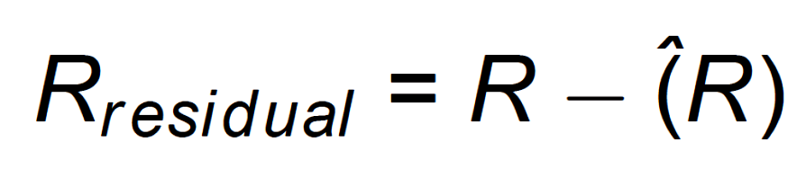
The closeness of the reconstructed matrix to the original can be used to gauge how well the C components capture the variance in the original variables:

Slide 21
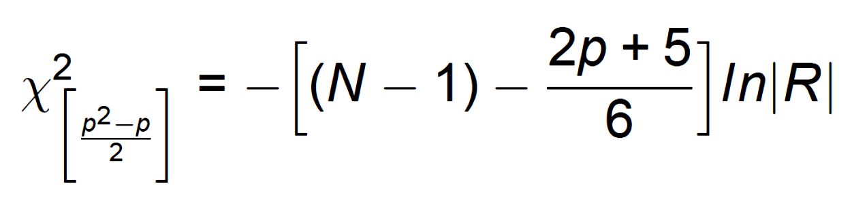
The correlation matrix, reconstructed correlation matrix, and the residual matrix play a role in determining how many components should be derived.
This is Bartlett’s test of sphericity, a test that the matrix R is an identity matrix. A modification of this test can be applied to residual matrices to test if additional components should be extracted.
Notes:
No need to factor an identity matrix.

Slide 22
Two other methods are commonly used to determine how many components are necessary to capture the information in the original variables:
  The scree test
  Kaiser’s λ > 1.0 rule
The scree test is based on the idea that a meaningful component should have an eigenvalue that is noticeably different from what would emerge from random data.
The “λ > 1.0” rule is based on the idea that a component should have more variance than any random item.
Notes:
Any random item in standard score form will have variance of 1.

Slide 23
Ofir and Simonson (2001) collected data (N = 195) on an individual difference measure called “need for cognition.” They wanted to know if this 18-item scale was best described by one dimension. If so, a single composite score would be an appropriate summary for research purposes.
[ ] 3. Thinking is not my idea of fun.
[ ] 7. I only think as hard as I have to.
[ ] 11. I really enjoy a task that involves coming up
with new solutions to problems.
[ ] 13. I prefer my life to be filled with puzzles
that I must solve.

Slide 24
Each items is rated using the following scale:
  1 = very characteristic of me
  2 = somewhat characteristic of me
  3 = neutral
  4 = somewhat uncharacteristic of me
  5 = very uncharacteristic of me
To keep interpretation of the principal components analysis simpler, items are scored to be in a consistent direction.

Slide 25
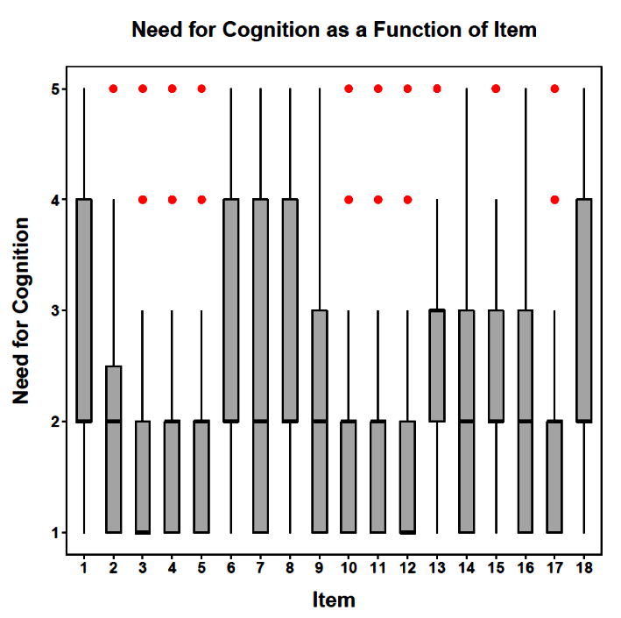
The crude measurement scale can produce distributions that vary considerably across items. This can complicate analyses.

Slide 26
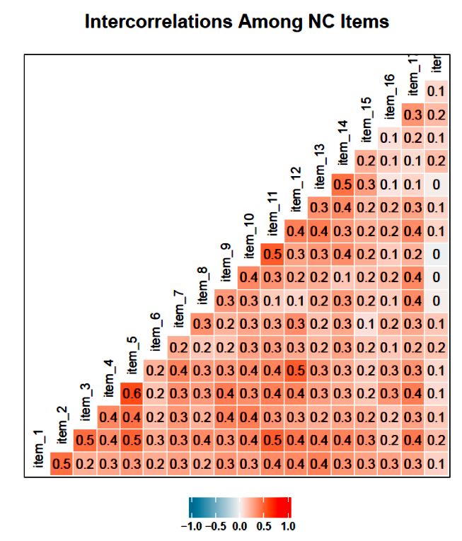
A heat map for the correlation matrix can assist examining a large matrix. Patterns in the data, if present, are easier to detect.
This heat map suggests fairly homogeneous correlations indicative of a single principal component.

Slide 27
Missing data can complicate PCA analyses. Listwise deletion insures that the correlation matrix is consistent, but the available sample size will be at a minimum. Pairwise deletion conserves cases, but can produce inconsistent correlations. Imputation preserves sample size but can encounter estimation difficulties. All of these procedures have assumptions that must be carefully considered.

Slide 28
Two tests are available for determining if a principal components analysis should be conducted. In addition to Bartlett’s test of sphericity, the Kaiser-Meyer-Olkin Measure of Sampling Adequacy (MSA) can be used to determine if common factor variance underlies the correlations in a matrix.
The MSA ranges between 0 and 1, with the following guidance for interpretation: .90 and above (undeniable evidence for factorability), .80 to .89 (very strong evidence), .70 to .79 (modest evidence), .60 to .69 (weak evidence), .50 to .59 (very weak evidence), and below .50 (unacceptable for factoring).

Slide 29
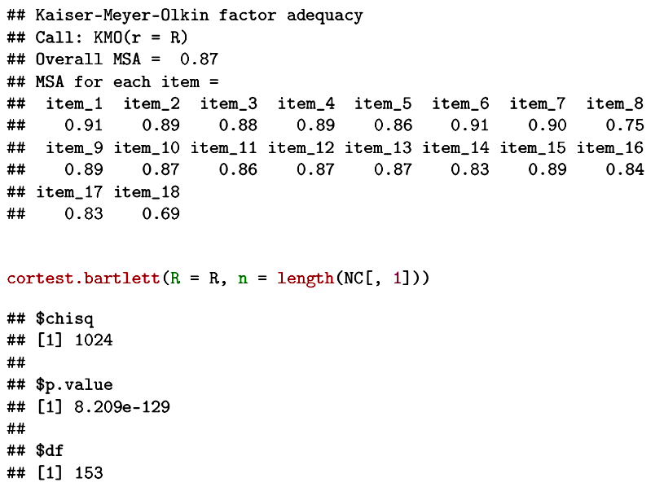
The correlation matrix is not an identity matrix and can be analyzed using principal components.
Notes:
If two variables share a common factor with other
variables, their partial correlation (aij) will be small,
indicating the unique variance they share.
If aij ≅ 0.0
The variables are measuring a
common factor, and KMO ≅ 1.0
If aij ≅ 1.0
The variables are not measuring a
common factor, and KMO ≅ 0.0

Slide 30
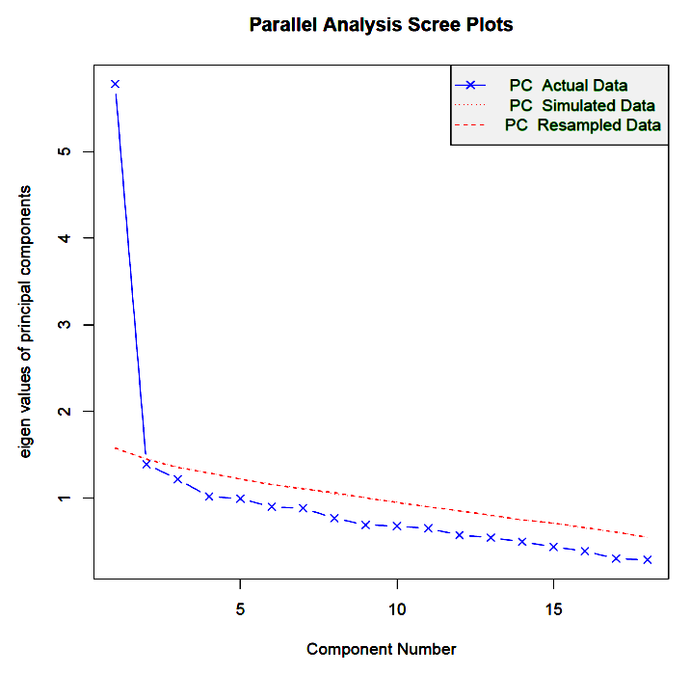
One dominant dimension appears to underlie the data.

Slide 31
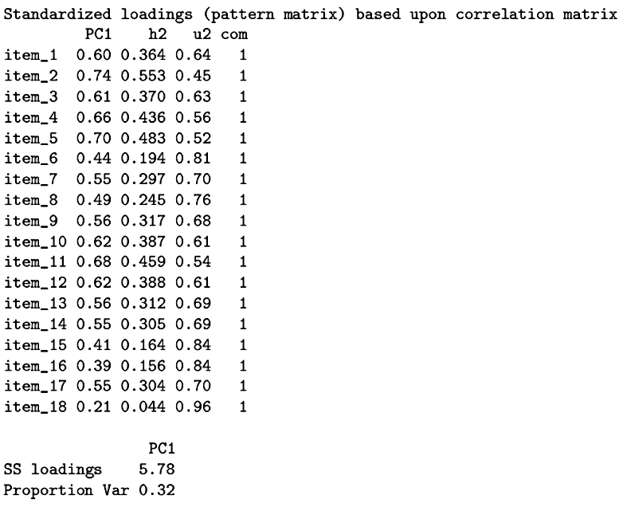
The items vary in the strength of their associations with the principal component (related to their weights in the linear combination).
The principal component accounts for 32% of the variability in the original data.

Slide 32
The scree test suggests a single component is required, but several additional components have eigenvalues greater than 1.00. Are those meaningful? Are they just error? The principal components analysis will capitalize on chance relations in the data and extract some components with eigenvalues greater than 1.00.
One way to address this question is to determine what pattern of eigenvalues would emerge if the data were simply random.

Slide 33
One approach, first suggested by Horn, is based on generating a new matrix of random, normally distributed variables. This matrix is the same size as the original data matrix.
Another approach, patterned after bootstrapping, generates a new matrix of data by resampling with replacement from the original data matrix. Each data point is independently (not case) sampled.
These random data are then analyzed with principal components analysis and serve as a baseline for the PCA of the actual data.
Notes:
Horn’s procedure is also called parallel analysis.

Slide 34
One component appears to be sufficient.

Slide 35
The ability of the principal components to account for each variable’s variance is indicated by the communality.

Slide 36

If the extracted components are sufficient to account for the variance in the original variables, then the correlations among the residuals should be trivial, indistinguishable from an identity matrix, and not worth additional extraction.

Slide 37
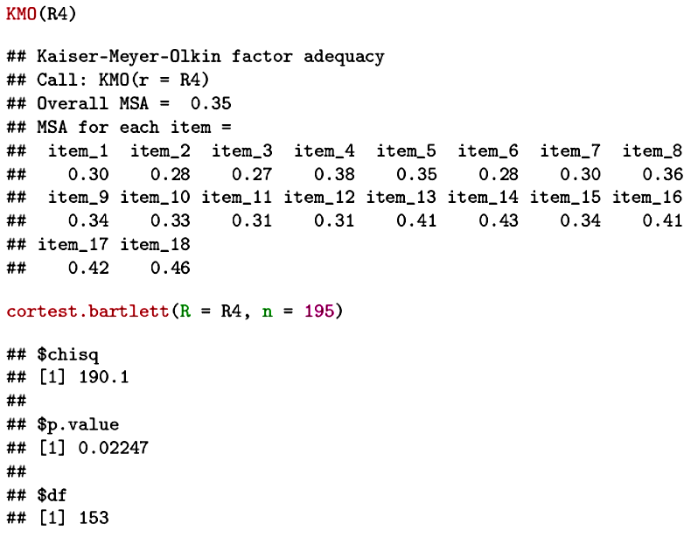
Mixed evidence, but probably not worth additional extraction.

Slide 38
Next time . . .
Finding outliers and verifying multivariate normality with PCA.

